Slide 1

Volume & glue calculations
MATH 1435 Math Fundamentals

Slide 2
Volume
Volume is a 3 dimensional measurement of an object. We measure the objects length, width and depth.
Volume is expressed in cubic units ( m³, ft³), also as millilitres, Litres, ounces, pint, quart and gallon.
Typically liquids are measured in millilitres, litres, ounces, pint, quart and gallon. Solid objects are measured in cubic centimetres, cubic metres, cubic yards, cubic feet, and cubic inches etc.
Volume is generally used to calculate volume of cabinets for shipping.

Slide 3
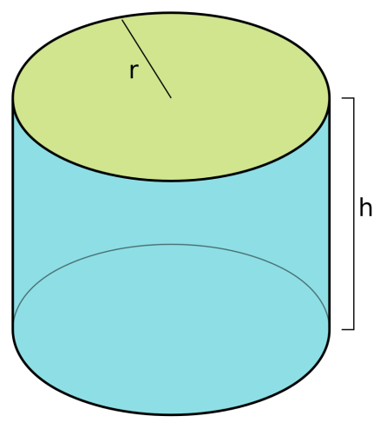
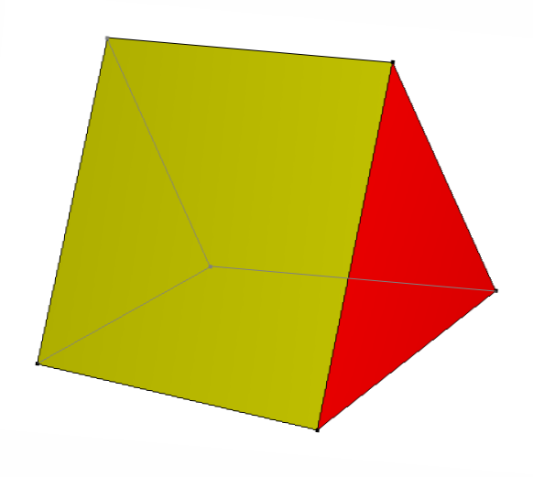
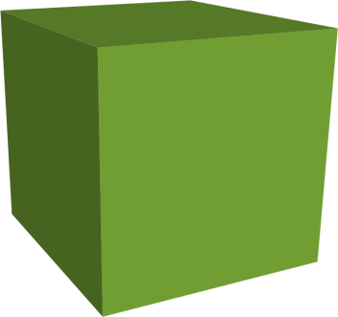


Volume – cube, cylinder & prisms
L
D
W
Volume = L x W x D
$$Volume= πr² x h$$
Volume = $\frac{bxh}{2} x L$

Slide 4
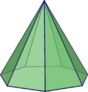
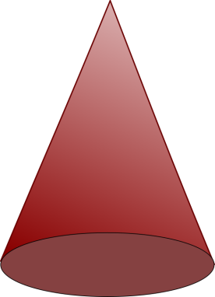


Volume - cones
Cones, square base pyramids and octagonal base pyramids
The volume of any symmetrical object that comes to a point is 1/3 the volume of an object with the same end shape and dimension.
The formula is as follows:
Volume = $\frac{end area x height}{3}$

Slide 5
Chemical mixes
Mixing glue and finishes to their correct proportions is required in order to maintain the properties of the glue or finishing materials.
The bond, strength and cure time of glue can be affected if too much water or catalyst is added.
Cure time, curing properties, durability and adhesion between coats can be affected if the finish/ catalyst ratio is not correct.
Mixes can be in parts, weight or volume.

Slide 6
Chemical mixes - example
Lets look at an example:
We have a recipe for an oil rubbed finish. The recipe calls for:
1/3 Boiled Linseed oil
1/3 varnish
1/3 mineral spirits
If we wanted a total of 15L of finish. How much of each item do we need?
1/3= 0.3333
0.3333 x 15 = 5L
Therefore, you would need 5L of each.

Slide 7
Chemical mixes – example 2
You have just bought a new glue for your veneer stitcher, it requires the following mixture:
13 parts resin
3 parts catalyst
1 part water
If the veneer stitcher glue reserve holds 500ml. How much of each item do you need?
Answer:
13 + 3 + 1 = 17 parts total
500ml ÷ 17 parts = 29.41 ml/ part
Resin – (29.41 x 13) = 382.33ml
Catalyst – (29.41 x 3) = 88.23ml
Water – (29.41 x 1) = 29.41ml

Slide 8
Multiple Panel Chemical mixes
Things to keep in mind when mixing a batch.
The total amount of units or panels needed.
Number of coats (finishing) or plies (glue calc).
The proper mix ratio.
Waste factor.

Slide 9
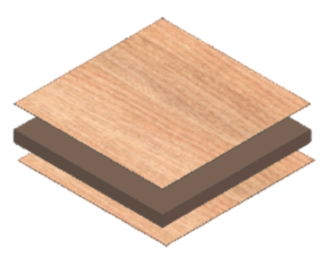
Multiple Panel Calculations Example
Calculate the following glue requirements:
42 pcs – 3 ply panels 36” x 24”
Glue specs
20 parts resin
4 parts catalyst
1 part water
Coverage 20 g/sqft
Waste 10%

Slide 10
Step Through
Calculate the square foot of 1 glue line.
Panel size 36” x 24” (convert to feet)
(36/12) x (24/12) = 6 sqft (one glue line)
Multiply by the number of glue lines for 1 panel.
6 sqft per glue line x 2 glue lines per panel (3 ply).
12 sqft of glue lines per panel.
Multiply by the number of panels needed.
12 sqft of glue lines per panel x 42 panels
504 sqft of glue for the whole job.

Slide 11
Step Through cont.
Calculate the weight of glue required.
504 sqft x 20 g per sqft =
10,080 g of glue required.
Add the waste to the glue.
10,080 g of glue + 10% =
(10,080 x 1.1) = 11, 088 g of glue with waste added.

Slide 12
Step Through cont. – 2nd page.
Now that we have the total amount of glue required, we need to calculate the amount of each of the parts of the glue mix.
Glue specs – 20 parts resin, 4 parts catalyst, 1 part water.
A total of 25 parts.
11,088 g / 25 parts = 443.52 g per part.
Therefore:
20 parts resin x 443.52 g per part = 8,870.4 g Resin
4 part catalyst x 443.52 g per part = 1,774.08 g Catalyst
1 part water x 443.52 g per part = 443.52 g Water

